Slide 1
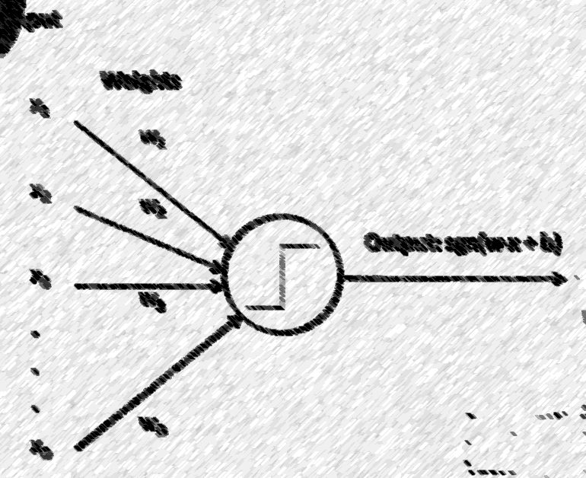

Lecture 7: Perceptron
CSE445 Machine Learning
Dr. Jilan Samiuddin (JSA)
Assistant Professor
North South University

Slide 2
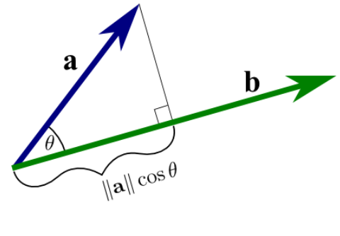
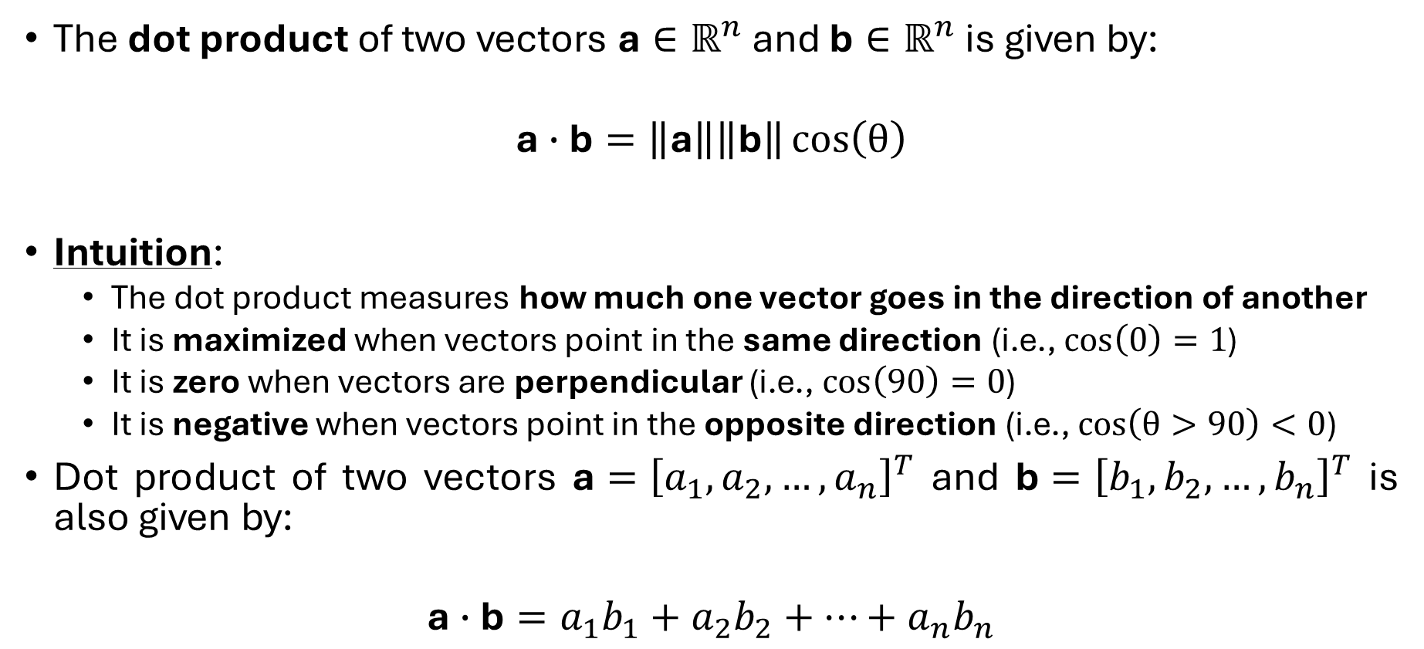
Linear Algebra: Dot Product
The dot product of two vectors $\text{a}∈ℝ^{n}$ and $\text{b}∈ℝ^{n}$ is given by:
$$\text{a}∙\text{b}=\left\|\text{a}\right\|\left\|\text{b}\right\|\cos\left(θ\right)$$
Intuition:
The dot product measures how much one vector goes in the direction of another
It is maximized when vectors point in the same direction (i.e., $\cos\left(0\right)=1$)
It is zero when vectors are perpendicular (i.e., $\cos\left(90\right)=0$)
It is negative when vectors point in the opposite direction (i.e., $\cos\left(θ>90\right)<0$)
Dot product of two vectors $\text{a}={\left[a_{1},a_{2},…,a_{n}\right]}^{T}$ and $\text{b}={\left[b_{1},b_{2},…,b_{n}\right]}^{T}$ is also given by:
$$\text{a}∙\text{b}=a_{1}b_{1}+a_{2}b_{2}+…+a_{n}b_{n}$$

Slide 3
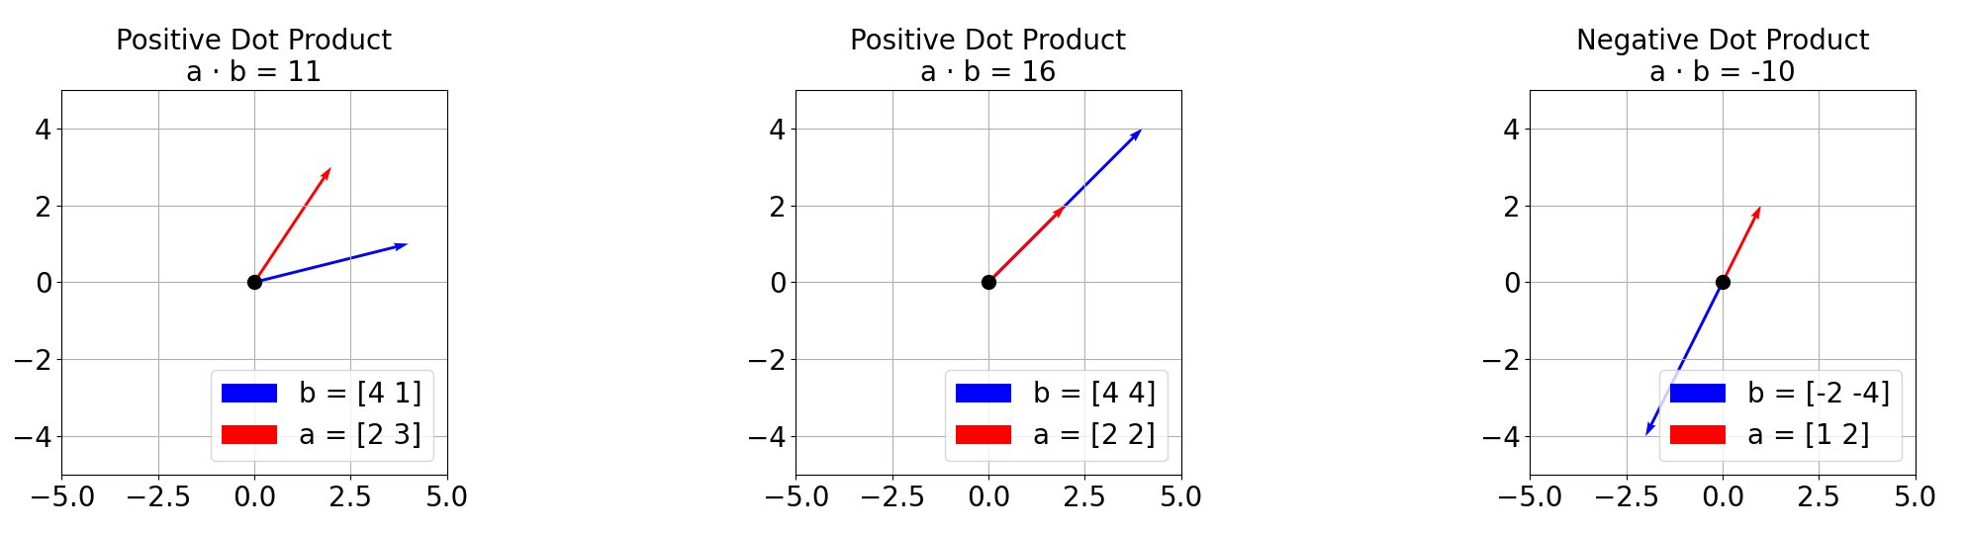
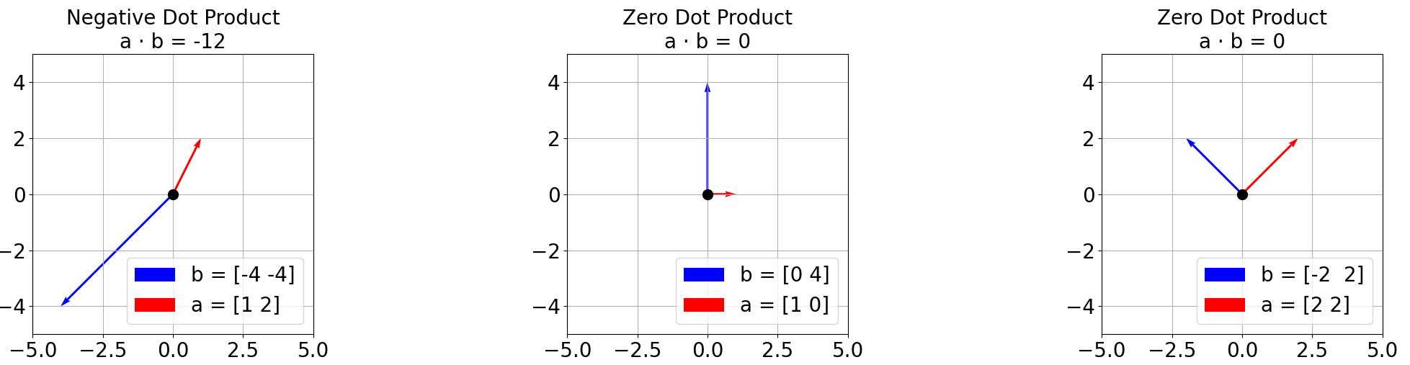
Dot Product – Examples

Slide 4
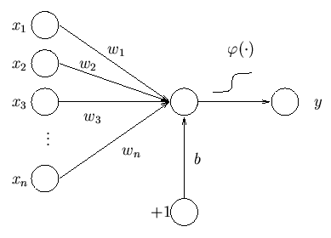
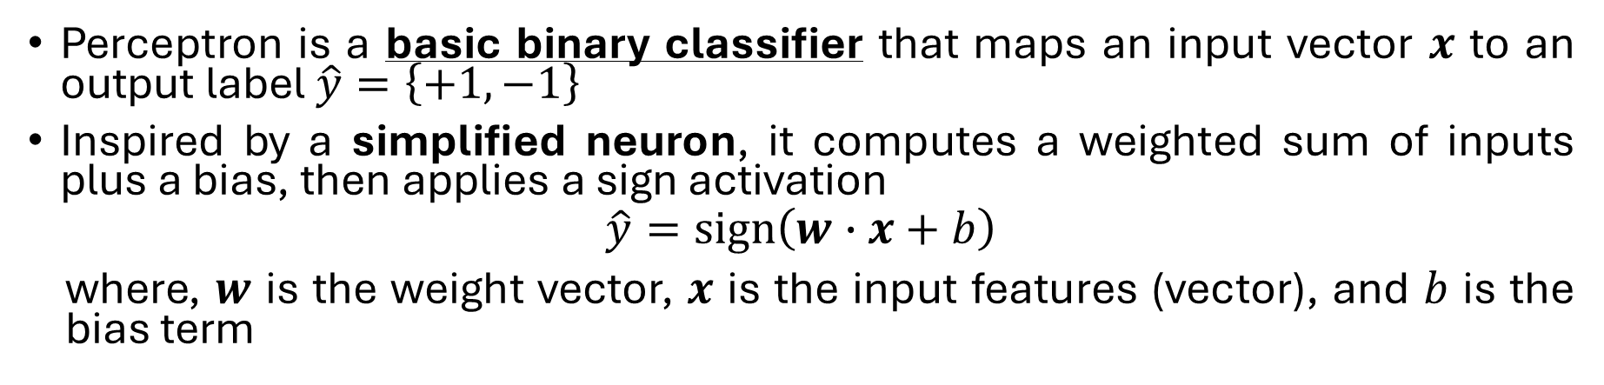

Perceptron
Perceptron is a basic binary classifier that maps an input vector $x$ to an output label $\hat{y}=\left\{+1, −1\right\}$
Inspired by a simplified neuron, it computes a weighted sum of inputs plus a bias, then applies a sign activation
$$\hat{y}=sign\left(w∙x+b\right)$$
where, $w$ is the weight vector, $x$ is the input features (vector), and $b$ is the bias term
sign
$$\hat{y}$$

Slide 5
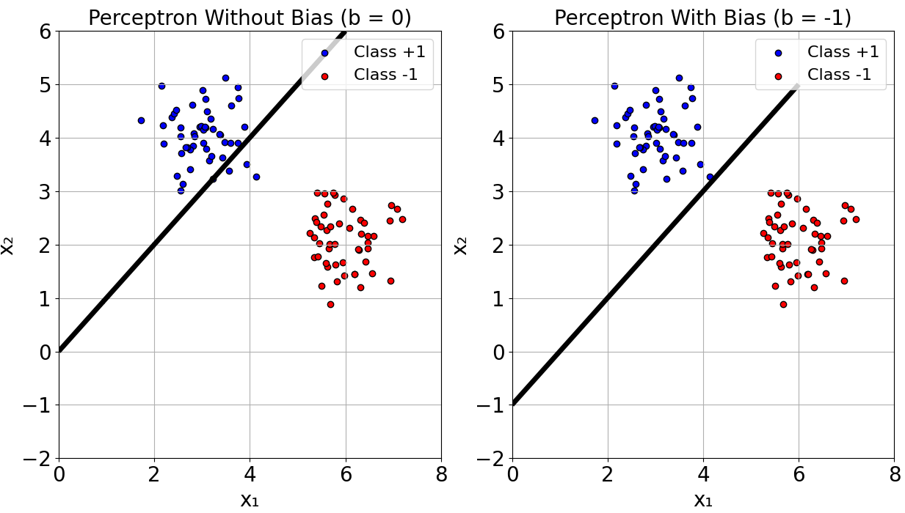
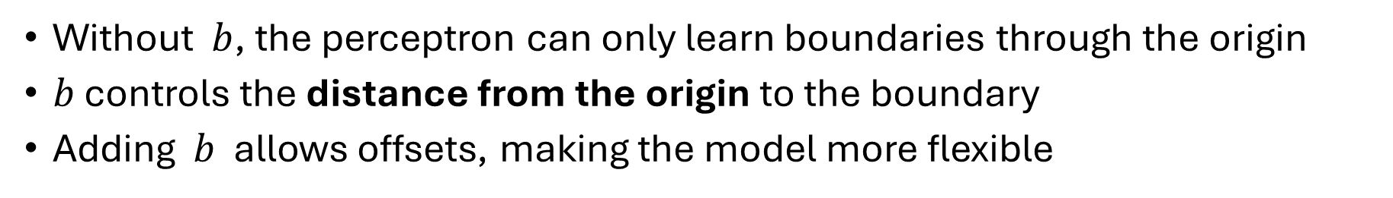
The bias term
Without $b$, the perceptron can only learn boundaries through the origin
$b$ controls the distance from the origin to the boundary
Adding $b$ allows offsets, making the model more flexible

Slide 6
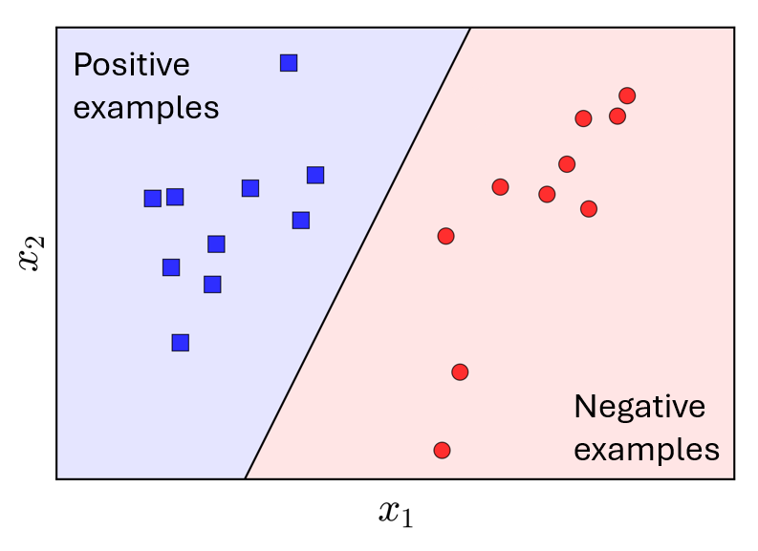
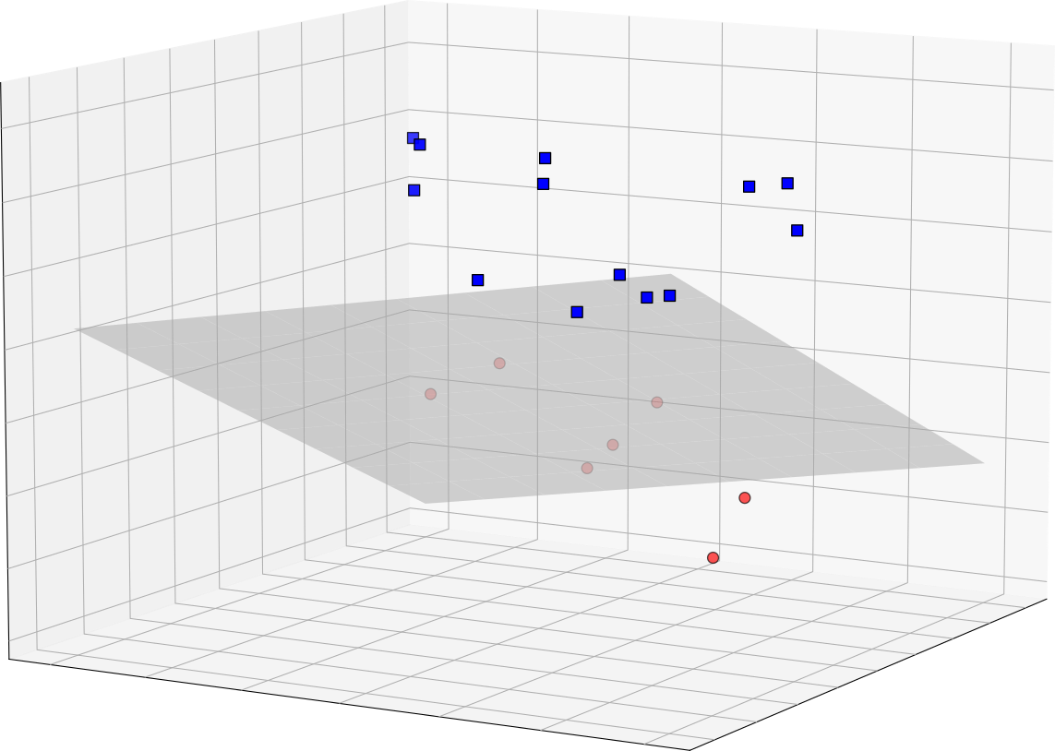






Perceptron (contd.)
Assumption: The data are linearly separable
Note 1: Weight vector is perpendicular to the decision boundary (hyperplane)
Note 2: These hyperplanes can be a line in 2D, a plane in 3D. Beyond 3D, it is hard to visualize
$$\left(w∙x+b\right)>0$$
Weight vector: $w$
$$\left(w∙x+b\right)<0$$
Positive examples
$\left(w∙x+b\right)>0$
Decision Boundary (Hyperplane), H: $\left(w∙x+b=0\right)$
Hyperplane, H: $\left(w∙x+b=0\right)$
Negative examples
$\left(w∙x+b\right)<0$

Slide 7
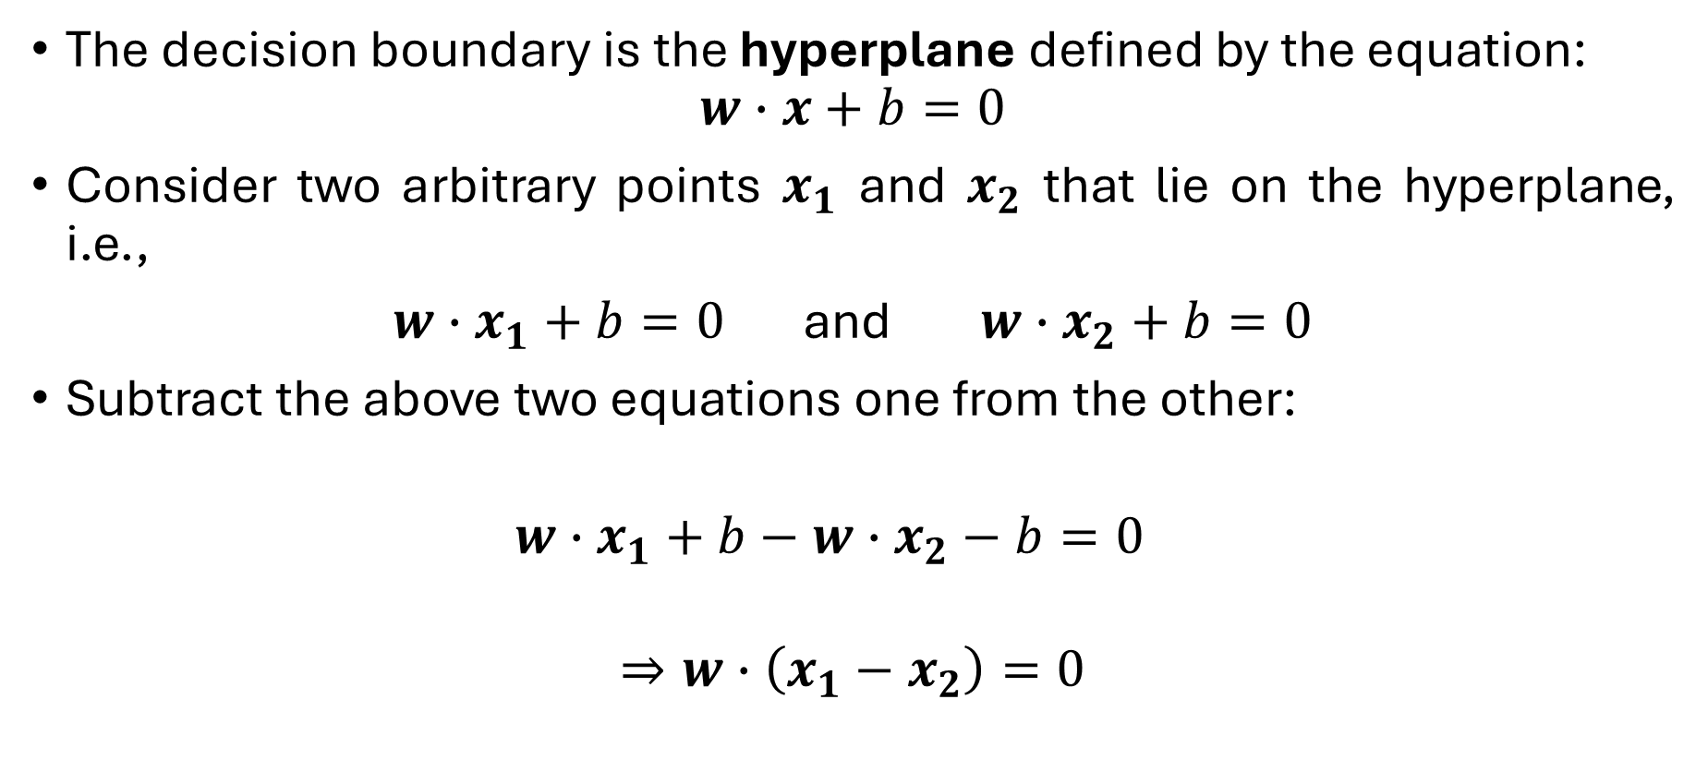

Proof: $w$ is perpendicular to H
The decision boundary is the hyperplane defined by the equation:
$$w∙x+b=0$$
Consider two arbitrary points $x_{1}$ and $x_{2}$ that lie on the hyperplane, i.e.,
$w∙x_{1}+b=0$ and $w∙x_{2}+b=0$
Subtract the above two equations one from the other:
$$w∙x_{1}+b−w∙x_{2}−b=0$$
$$⇒w∙\left(x_{1}−x_{2}\right)=0$$

Slide 8
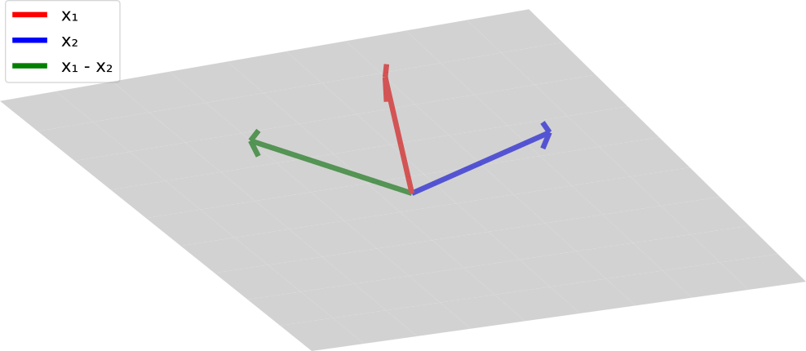
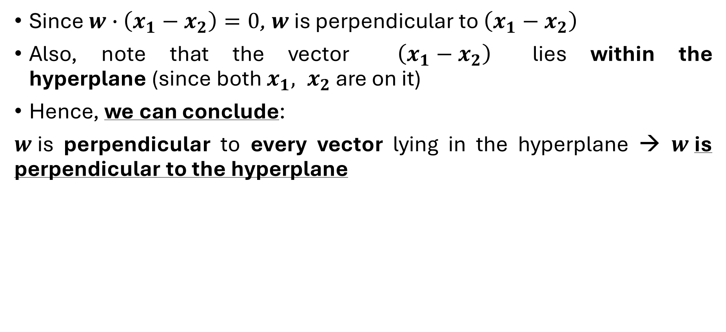
Proof (contd.)
Since $w∙\left(x_{1}−x_{2}\right)=0$, $w$ is perpendicular to $\left(x_{1}−x_{2}\right)$
Also, note that the vector $\left(x_{1}−x_{2}\right)$​ lies within the hyperplane (since both $x_{1}, x_{2}$ are on it)
Hence, we can conclude:
$w$is perpendicular to every vector lying in the hyperplane → $w$is perpendicular to the hyperplane
2D example
3D example

Slide 9
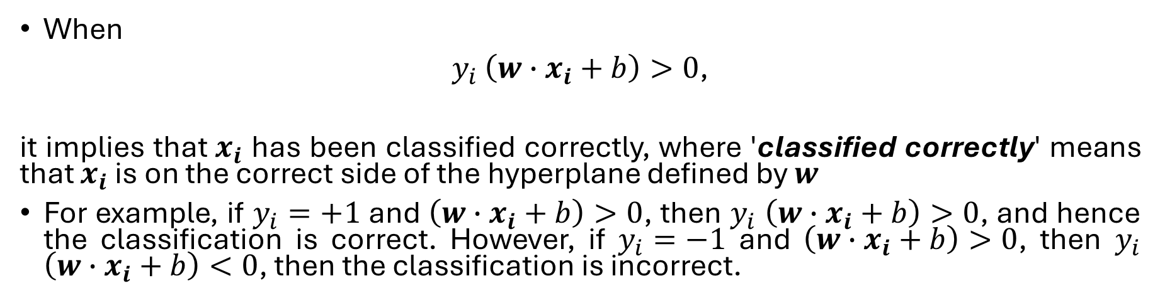
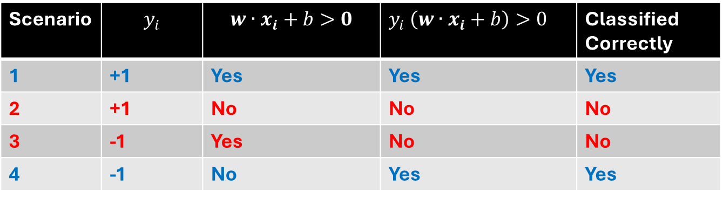
Perceptron (contd.)
When
$y_{i}$ $\left(w∙x_{i}+b\right)>0$,
it implies that $x_{i}$ has been classified correctly, where 'classified correctly' means that $x_{i}$ is on the correct side of the hyperplane defined by $w$
For example, if $y_{i}=+1$ and $\left(w∙x_{i}+b\right)>0$, then $y_{i}$ $\left(w∙x_{i}+b\right)>0$, and hence the classification is correct. However, if $y_{i}=−1$ and $\left(w∙x_{i}+b\right)>0$, then $y_{i}$ $\left(w∙x_{i}+b\right)<0$, then the classification is incorrect.
Scenario | $$y_{i}$$ | $$w∙x_{i}+b>0$$ | $y_{i}$ $\left(w∙x_{i}+b\right)>0$ | Classified Correctly
1 | +1 | Yes | Yes | Yes
2 | +1 | No | No | No
3 | -1 | Yes | No | No
4 | -1 | No | Yes | Yes

Slide 10
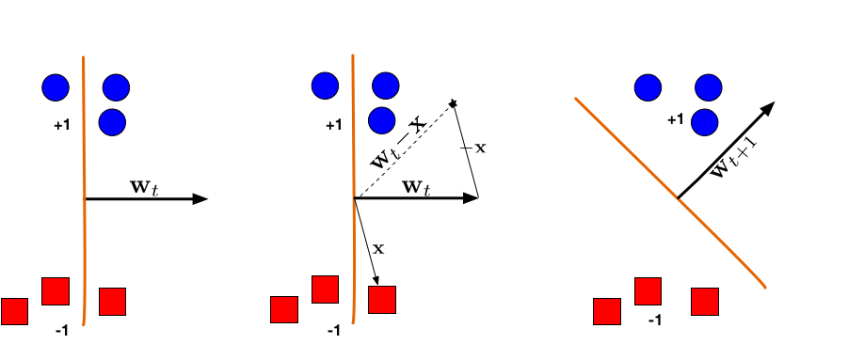

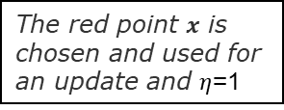
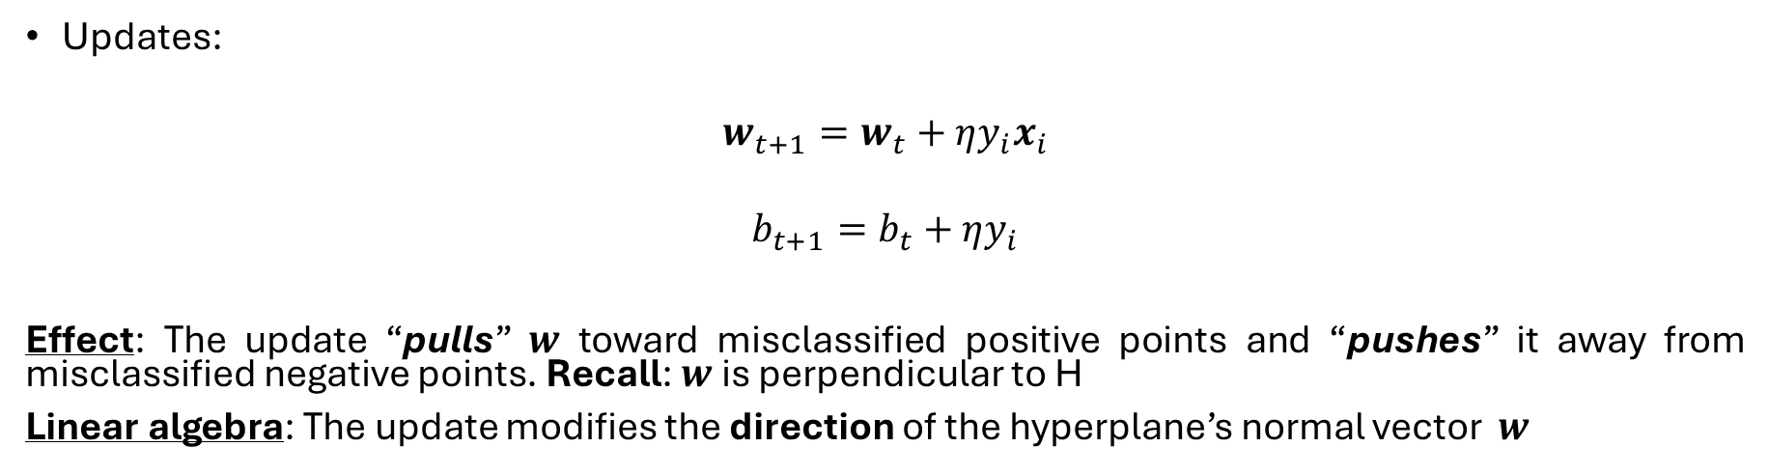

Updating weights $w$ and bias $b$
Updates:
$$w_{t+1}=w_{t}+ηy_{i}x_{i}$$
$$b_{t+1}=b_{t}+ηy_{i}$$
Effect: The update “pulls” $w$ toward misclassified positive points and “pushes” it away from misclassified negative points. Recall: $w$ is perpendicular to H
Linear algebra: The update modifies the direction of the hyperplane’s normal vector $w$
$η$ → learning rate
The red point $x$ is chosen and used for an update and $η$=1

Slide 11
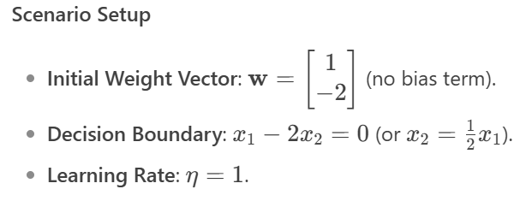
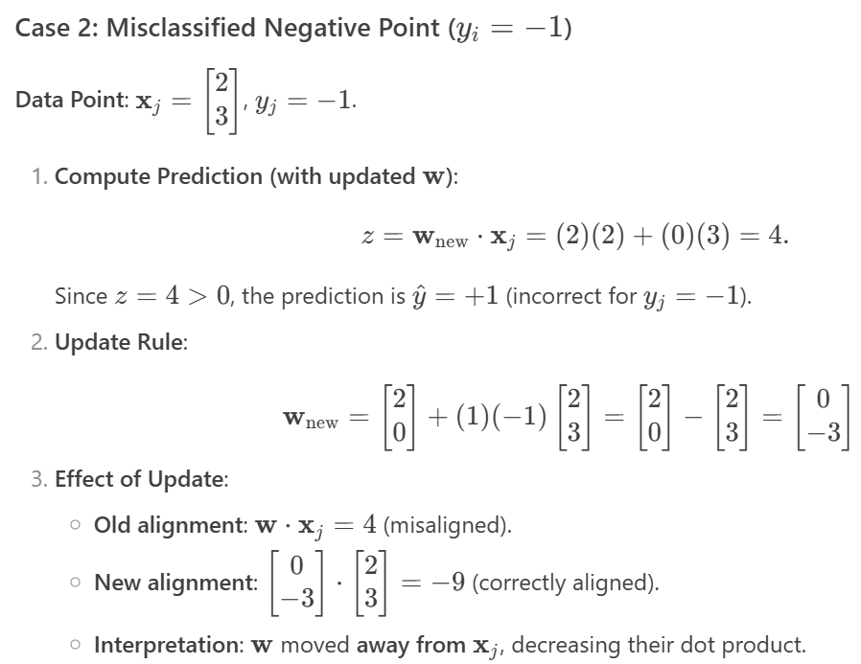
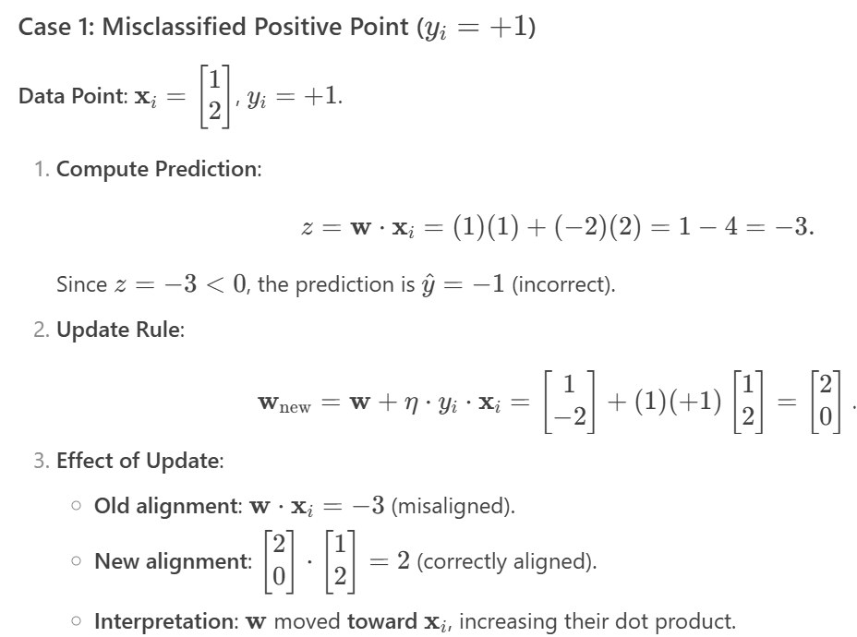
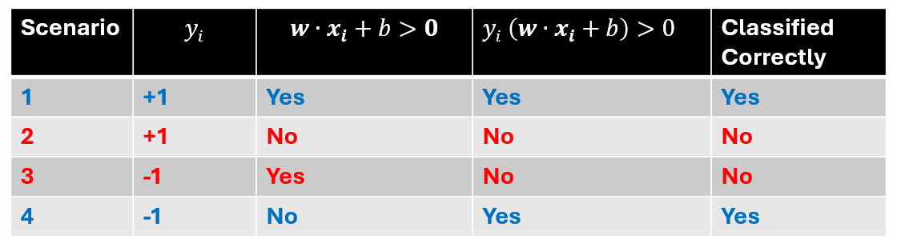

Updating $w$: Example (assume no bias, i.e., $b=0$)
← (Scenario 3)
← (Scenario 4)
← (Scenario 2)
← (Scenario 1)

Slide 12

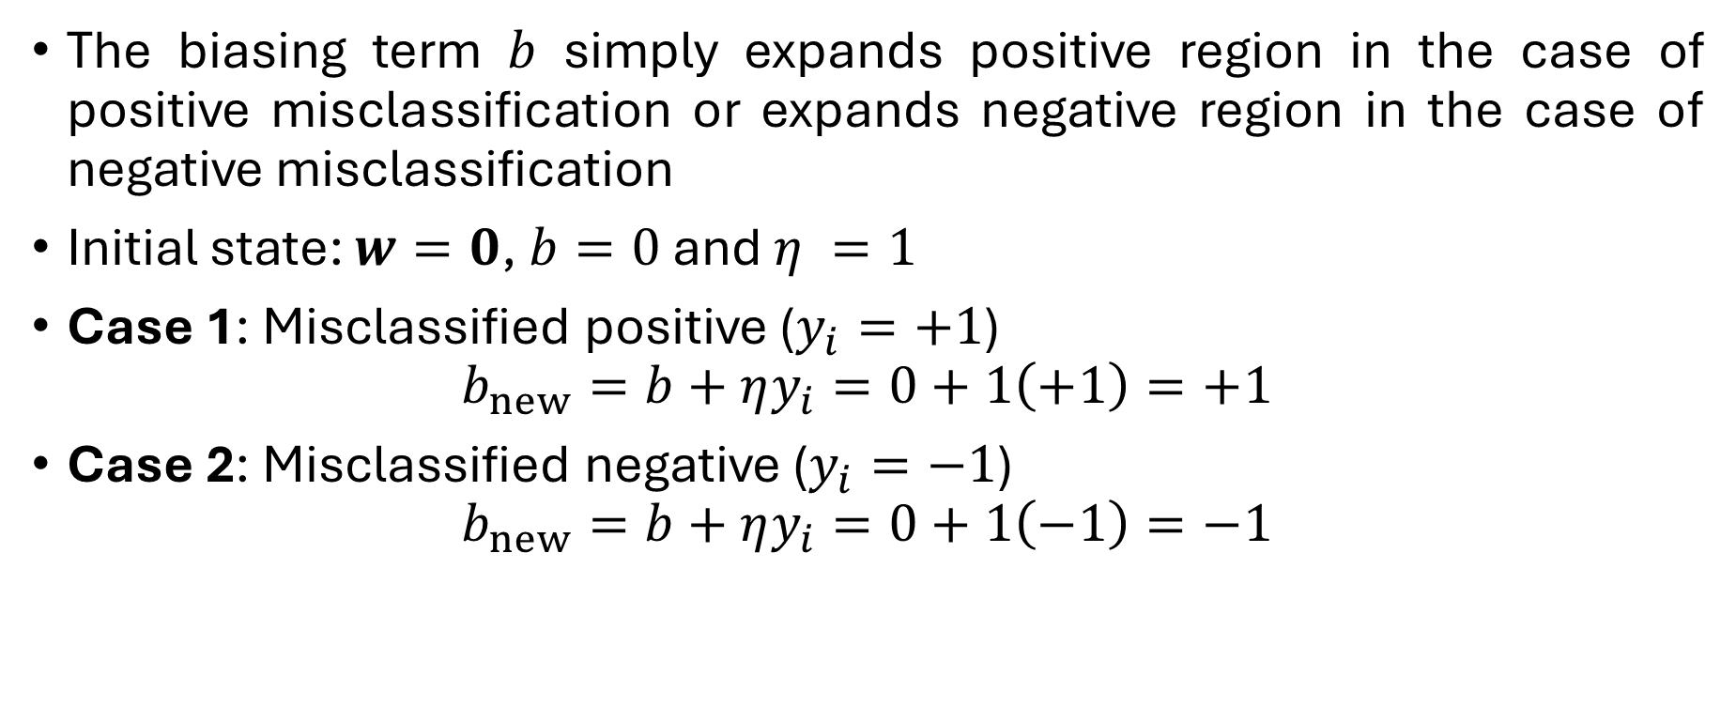
Updating $b$: Example
The biasing term $b$ simply expands positive region in the case of positive misclassification or expands negative region in the case of negative misclassification
Initial state: $w=0$, $b=0$ and $η =1$
Case 1: Misclassified positive ($y_{i}=+1$)
$$b_{new}=b+ηy_{i}=0+1\left(+1\right)=+1$$
Case 2: Misclassified negative ($y_{i}=−1$)
$$b_{new}=b+ηy_{i}=0+1\left(−1\right)=−1$$

Slide 13
Perceptron Algorithm
Step 1: Initialize parameters
Step 2: Compute prediction
Step 3: Check for misclassification on the training data
Step 4: Update weights and bias based on the misclassified data
Step 5: Check convergence (exit early if no mistakes occur)
Step 6: Repeat steps 2-5 until convergence
NOTE: If the data is linearly separable, convergence is guaranteed! (See the proof of convergence for yourself)

Slide 14
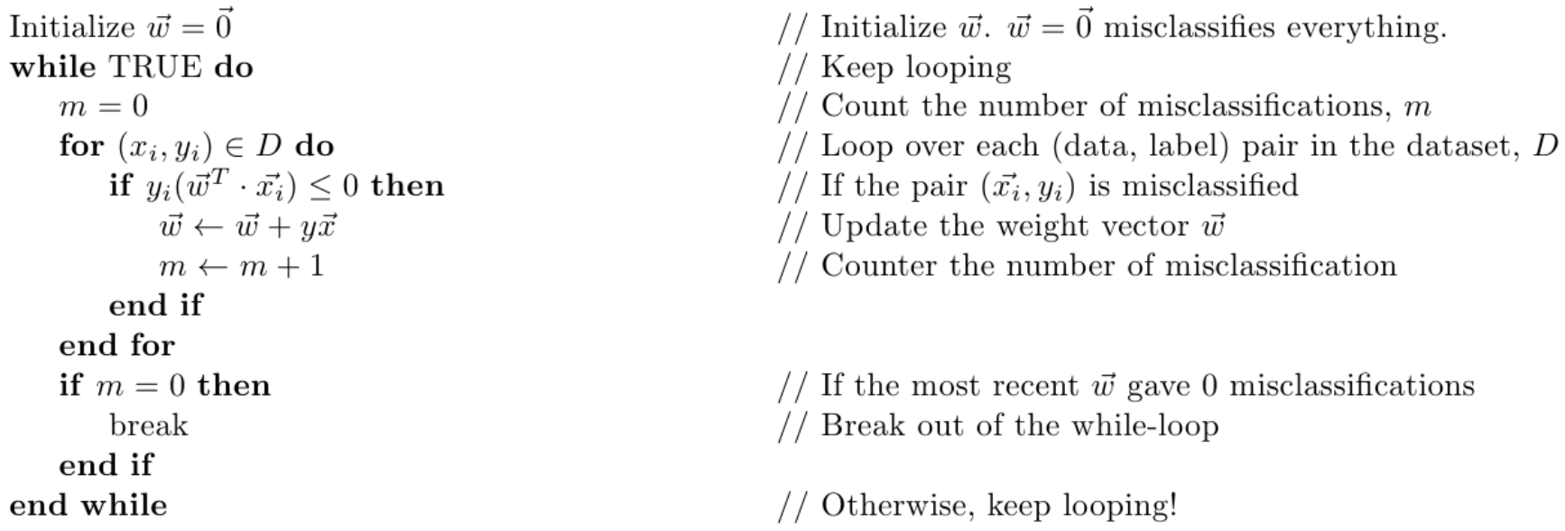
Perceptron Algorithm – Pseudo Code

Slide 15
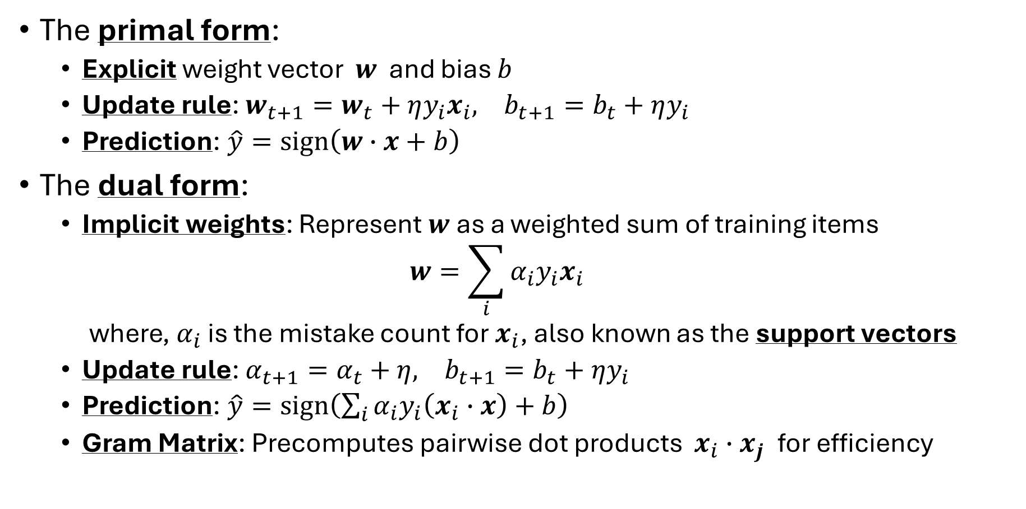
Duality in Perceptron
The primal form:
Explicit weight vector $w$ and bias $b$
Update rule: $w_{t+1}=w_{t}+ηy_{i}x_{i}, b_{t+1}=b_{t}+ηy_{i}$
Prediction: $\hat{y}=sign\left(w∙x+b\right)$
The dual form:
Implicit weights: Represent $w$ as a weighted sum of training items
$$w=\sum_{i}{α_{i}y_{i}x_{i}}$$
where, $α_{i}$ is the mistake count for $x_{i}$, also known as the support vectors
Update rule: $α_{t+1}=α_{t}+η, b_{t+1}=b_{t}+ηy_{i}$
Prediction: $\hat{y}=sign\left(\sum_{i}{α_{i}y_{i}\left(x_{i}∙x\right)}+b\right)$
Gram Matrix: Precomputes pairwise dot products $x_{i}∙x_{j}$​ for efficiency

Slide 16
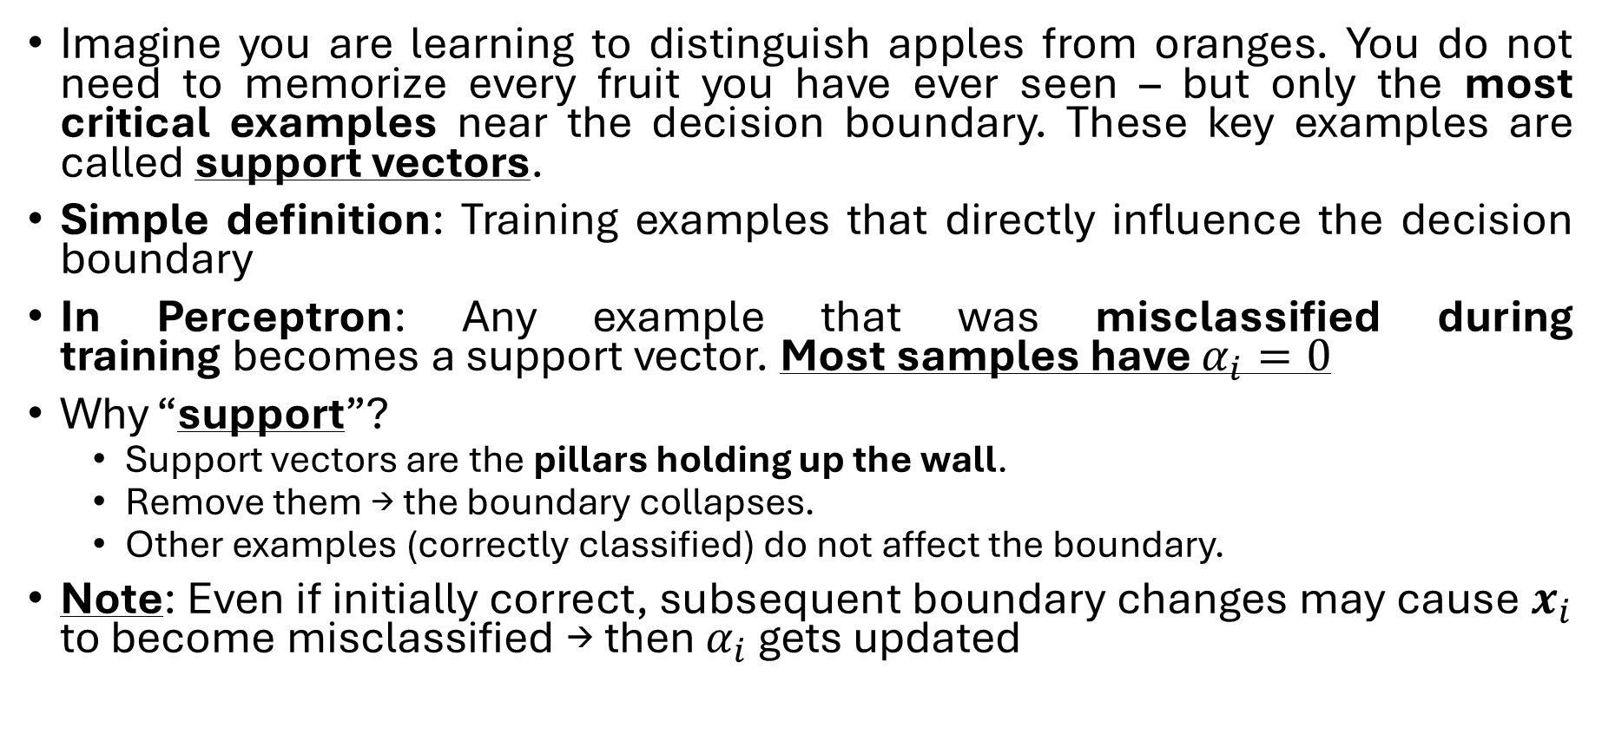
Support Vectors
Imagine you are learning to distinguish apples from oranges. You do not need to memorize every fruit you have ever seen – but only the most critical examples near the decision boundary. These key examples are called support vectors.
Simple definition: Training examples that directly influence the decision boundary
In Perceptron: Any example that was misclassified during training becomes a support vector. Most samples have $α_{i}=0$
Why “support”?
Support vectors are the pillars holding up the wall.
Remove them → the boundary collapses.
Other examples (correctly classified) do not affect the boundary.
Note: Even if initially correct, subsequent boundary changes may cause $x_{i}$ to become misclassified → then $α_{i}$ gets updated

Slide 17
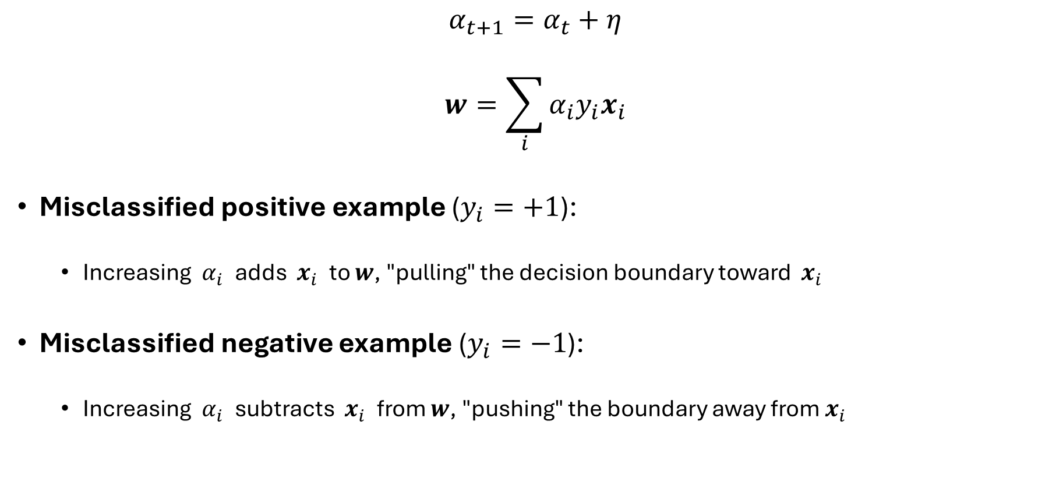
Interpretation of the update in the dual form
$$α_{t+1}=α_{t}+η$$
$$w=\sum_{i}{α_{i}y_{i}x_{i}}$$
Misclassified positive example ($y_{i}=+1$):
Increasing $α_{i}$​ adds $x_{i}$​ to $w$, "pulling" the decision boundary toward $x_{i}$
Misclassified negative example ($y_{i}=−1$):
Increasing $α_{i}$​ subtracts $x_{i}$​ from $w$, "pushing" the boundary away from $x_{i}$​

Slide 18
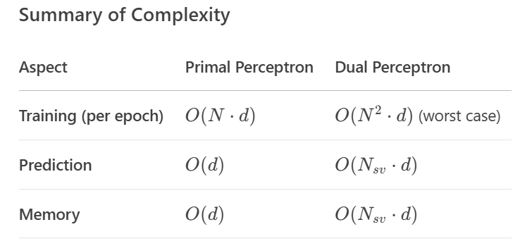

Complexity Comparison
$N$ is the total number of training samples

Slide 19
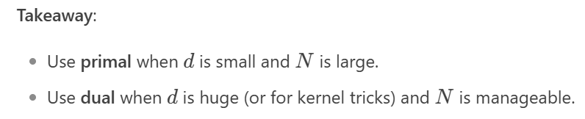
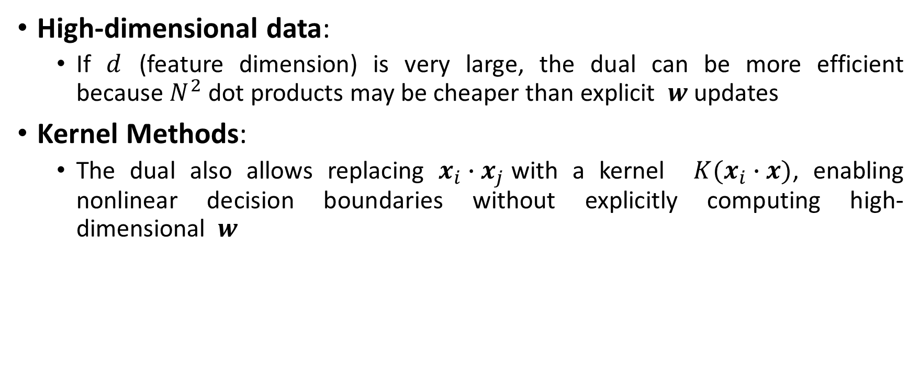
When to use the dual form?
High-dimensional data:
If $d$ (feature dimension) is very large, the dual can be more efficient because $N^{2}$ dot products may be cheaper than explicit $w$ updates
Kernel Methods:
The dual also allows replacing $x_{i}∙x_{j}$with a kernel ${K(x}_{i}∙x)$, enabling nonlinear decision boundaries without explicitly computing high-dimensional $w$

Slide 20

Mathematical Example
Classify 2D points given:
Positive: $x_{1}=\left[1, 2\right], y_{1}=+1$
Negative: $x_{2}=\left[3, 1\right], y_{2}=−1$
$η=1,w=\left[0, 0\right], b=0,α=\left[0, 0\right]$

Slide 21

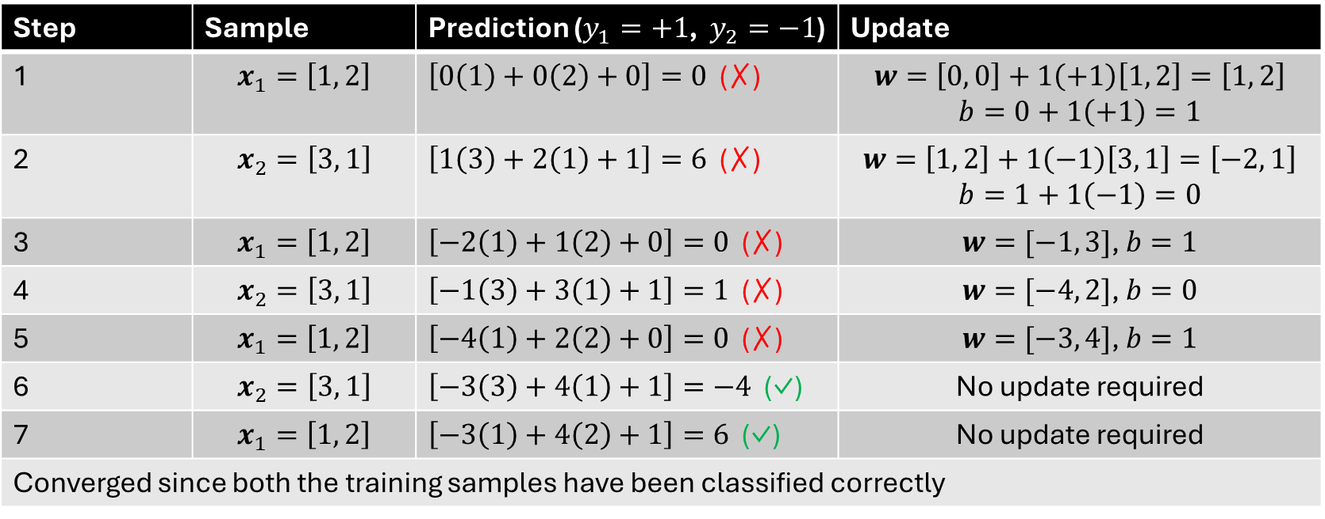
Primal Form Solution
Prediction: $\hat{y}=sign\left(w∙x+b\right)$
Update rule: $w_{t+1}=w_{t}+ηy_{i}x_{i}, b_{t+1}=b_{t}+ηy_{i}$
Step | Sample | Prediction ($y_{1}=+1$, $y_{2}=−1$) | Update
1 | $$x_{1}=\left[1, 2\right]$$ | $\left[0\left(1\right)+0\left(2\right)+0\right]=0$ (✗) | $$w=\left[0, 0\right]+1\left(+1\right)\left[1, 2\right]=\left[1, 2\right]$$ $$b=0+1\left(+1\right)=1$$
2 | $$x_{2}=\left[3, 1\right]$$ | $\left[1\left(3\right)+2\left(1\right)+1\right]=6$ (✗) | $$w=\left[1, 2\right]+1\left(−1\right)\left[3, 1\right]=\left[−2, 1\right]$$ $$b=1+1\left(−1\right)=0$$
3 | $$x_{1}=\left[1, 2\right]$$ | $\left[−2\left(1\right)+1\left(2\right)+0\right]=0$ (✗) | $w=[−1, 3]$, $b=1$
4 | $$x_{2}=\left[3, 1\right]$$ | $\left[−1\left(3\right)+3\left(1\right)+1\right]=1$ (✗) | $w=[−4, 2]$, $b=0$
5 | $$x_{1}=\left[1, 2\right]$$ | $\left[−4\left(1\right)+2\left(2\right)+0\right]=0$ (✗) | $w=[−3, 4]$, $b=1$
6 | $$x_{2}=\left[3, 1\right]$$ | $\left[−3\left(3\right)+4\left(1\right)+1\right]=−4$ (✓) | No update required
7 | $$x_{1}=\left[1, 2\right]$$ | $\left[−3\left(1\right)+4\left(2\right)+1\right]=6$ (✓) | No update required
Converged since both the training samples have been classified correctly

Slide 22



Dual Form Solution
$$\left(x_{1}∙x_{1}\right)=\left[\begin{matrix}1 \\ 2\end{matrix}\right]\left[\begin{matrix}1 \\ 2\end{matrix}\right]=\left(1\right)\left(1\right)+\left(2\right)\left(2\right)=5$$
$$\left(x_{1}∙x_{2}\right)=\left[\begin{matrix}1 \\ 2\end{matrix}\right]\left[\begin{matrix}3 \\ 1\end{matrix}\right]=\left(1\right)\left(3\right)+\left(2\right)\left(1\right)=5$$
$$\left(x_{2}∙x_{2}\right)=\left[\begin{matrix}3 \\ 1\end{matrix}\right]\left[\begin{matrix}3 \\ 1\end{matrix}\right]=\left(3\right)\left(3\right)+\left(1\right)\left(1\right)=10$$
Prediction: $\hat{y}=sign\left(\sum_{i}{α_{i}y_{i}\left(x_{i}∙x\right)}+b\right)$
Update rule: $α_{t+1}=α_{t}+η, b_{t+1}=b_{t}+ηy_{i}$
Step | Sample | Prediction ($y_{1}=+1$, $y_{2}=−1$) | Update
1 | $$x_{1}=\left[1, 2\right]$$ | $0\left(1\right)\left(5\right)+0\left(−1\right)\left(5\right)+0=0$ (✗) | $$α_{1}=0+1=1$$ $$b=0+1\left(+1\right)=1$$
2 | $$x_{2}=\left[3, 1\right]$$ | $1\left(1\right)\left(5\right)+0\left(−1\right)\left(10\right)+1=6$ (✗) | $$α_{2}=0+1=1$$ $$b=1+1\left(−1\right)=0$$
3 | $$x_{1}=\left[1, 2\right]$$ | $1\left(1\right)\left(5\right)+1\left(−1\right)\left(5\right)+0=0$ (✗) | $α_{1}=2$, $b=1$
4 | $$x_{2}=\left[3, 1\right]$$ | $2\left(1\right)\left(5\right)+1\left(−1\right)\left(10\right)+1=1$ (✗) | $α_{2}=2$, $b=0$
5 | $$x_{1}=\left[1, 2\right]$$ | $2\left(1\right)\left(5\right)+2\left(−1\right)\left(5\right)+0=0$ (✗) | $α_{1}=3$, $b=1$
6 | $$x_{2}=\left[3, 1\right]$$ | $3\left(1\right)\left(5\right)+2\left(−1\right)\left(10\right)+1=−4$ (✓) | No update required
7 | $$x_{1}=\left[1, 2\right]$$ | $3\left(1\right)\left(5\right)+2\left(−1\right)\left(5\right)+1=6$ (✓) | No update required
Converged since both the training samples have been classified correctly

Slide 23

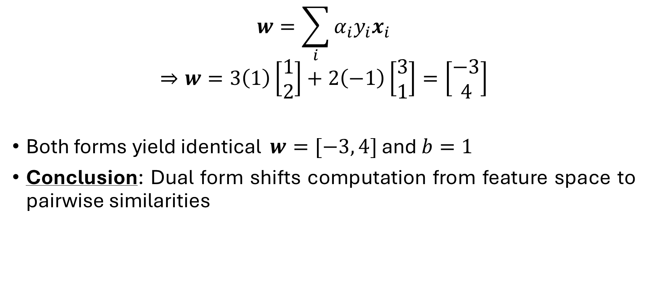
Recovering $w$ from dual form (if needed)
$$w=\sum_{i}{α_{i}y_{i}x_{i}}$$
$$⇒w=3\left(1\right)\left[\begin{matrix}1 \\ 2\end{matrix}\right]+2\left(−1\right)\left[\begin{matrix}3 \\ 1\end{matrix}\right]=\left[\begin{matrix}−3 \\ 4\end{matrix}\right]$$
Both forms yield identical $w=[−3, 4]$ and $b=1$
Conclusion: Dual form shifts computation from feature space to pairwise similarities

